Slide 1
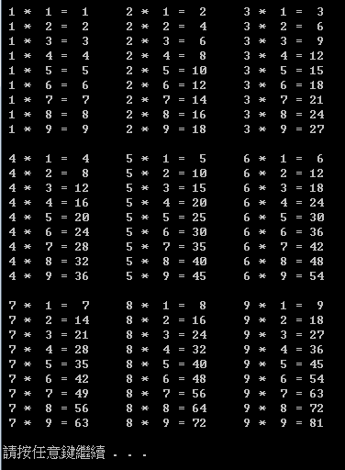

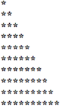
1.cpp (loop)
Input an integer n, use nested for to print the two graphs as below (n: n number of levels of stars)
輸入正整數數 n(此題不檢查n)，以巢狀(多層)for迴圈，印出下列兩個圖案(n代表n層星星)
(2)
(1) n=10

Slide 2
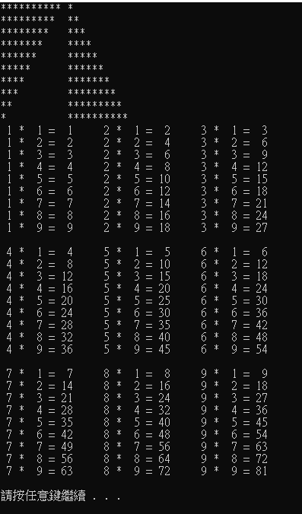

Slide 3
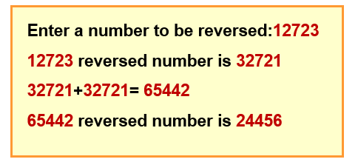
2.cpp: Reversing digits
(必須求得數字，不可以只是列印相反數字)
Write a program that reads an integer reversing the digits. For example, given the number 27631, then you get a new number 13672, and print it
數字部分必須用printf 的%d寫入，否則0分
12723 is a 5-digit number.
Hint:
  餘數求法: e.g. 12 % 7 = 5, 10 % 3 = 1
  273/10 => 27 (整數相除，餘數不計)

